Slide 1
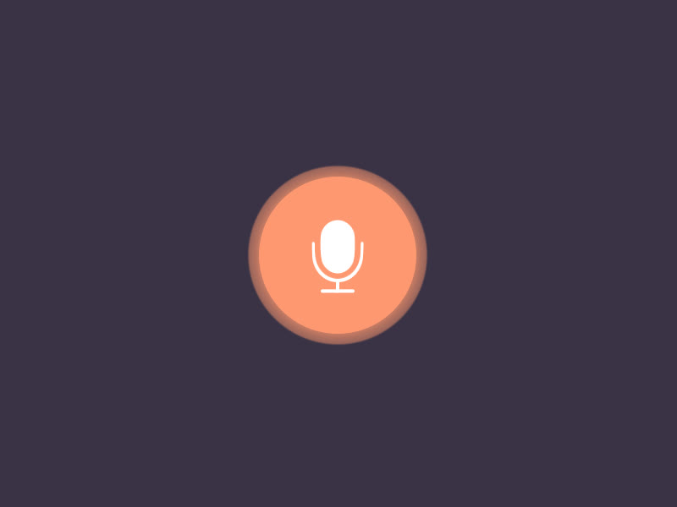

Beyond QWERTY-Voice Based Form Filling
-Lasya Pothineedi

Slide 2
Overview
1.Beyond QWERTY is a voice-based form filling project that uses speech recognition technology to allow users to complete forms by speaking instead of typing.
2.The main goal of the project is to remove language barriers, enabling users from diverse linguistic backgrounds to interact with forms without the need for typing.
3.The system is designed to help individuals who may have difficulty typing or are not fluent in the language of the form, making form completion easier and more inclusive.
4.Voice commands are used to input data into forms, reducing the effort and time required to fill out forms manually.
5.The system improves the efficiency of form filling by using voice commands to input data, reducing the time and effort required for manual typing.

Slide 3
Technologies:
Frontend:
HTML, CSS, JavaScript: These are used to design the user interface (UI) and ensure the form is interactive and responsive.
Backend:
Python: Used for the backend logic, processing speech input, and handling form data.
Flask: A lightweight Python framework used to create the web application and manage server-side functionality.
API:
Whisper: A speech-to-text API used to convert spoken input into text for form filling.
Google Translator: Helps in translating user input, enabling the system to support multiple languages and remove language barriers.

Slide 4
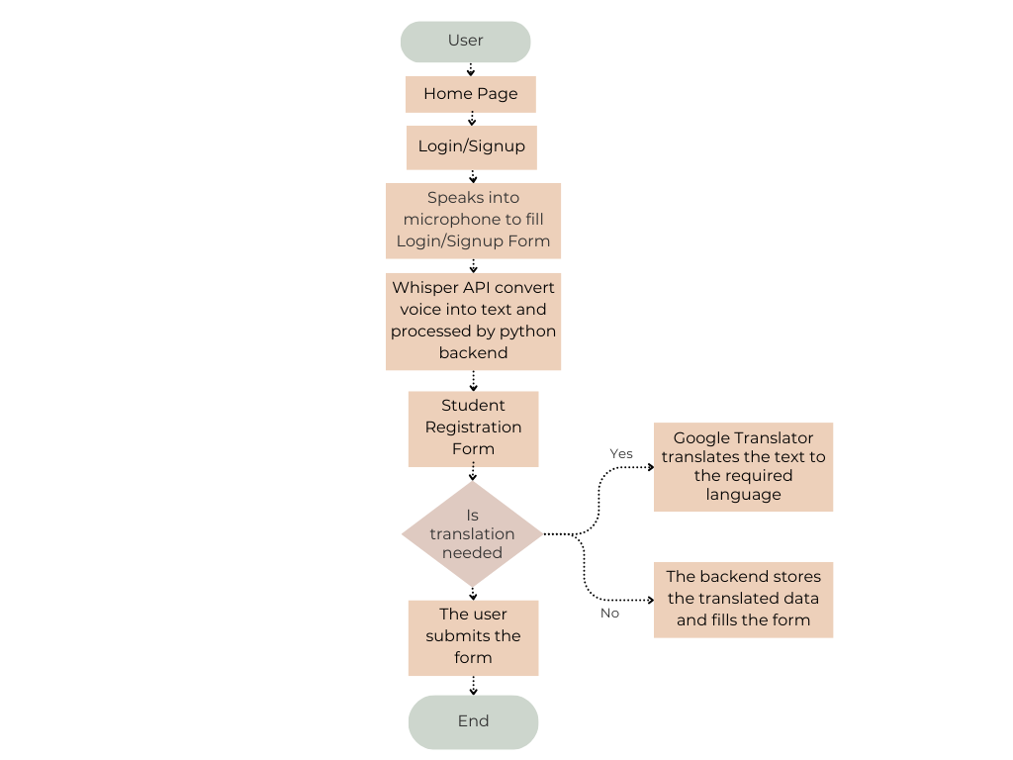
Work Flow

Slide 5
Learning Outcomes
Learned how to implement voice-based form filling using speech recognition and APIs.
Gained experience in programming with Python, useful for backend development and implementing logic.
Learned to manage databases and query data using SQL.
Understood how to integrate and work with APIs for adding external functionality like speech recognition and translation.
Gained hands-on experience in developing and implementing complete projects.
Learned to use Flask, a web framework, to build and manage web applications.

Slide 6
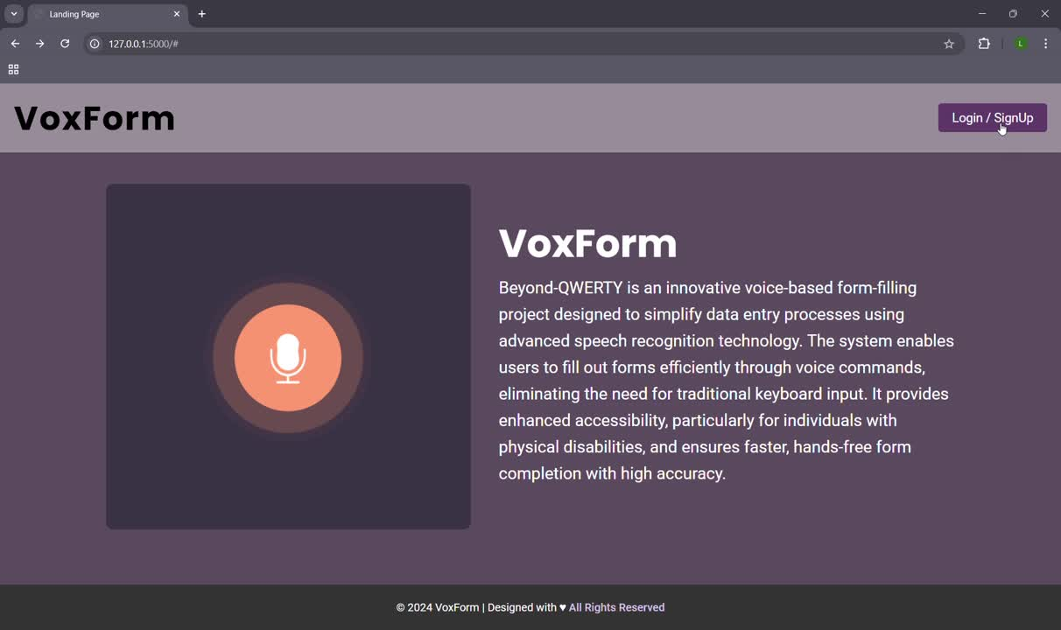
Project Execution

Slide 7
Conclusion
The Beyond QWERTY Voice-Based Form Filling Project successfully demonstrates how speech recognition and translation technologies can simplify form filling, making it more accessible and user-friendly. By removing language barriers and reducing the need for typing, the project provides an efficient solution for diverse users. It highlights the potential of combining innovative tools like Whisper API and Google Translator with web technologies to create inclusive and practical applications for everyday tasks.

Slide 8
Thank You !

